Slide 1
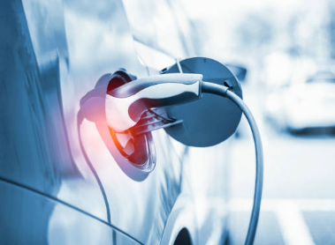
Electric Vehicle Dealership, United States
Prepared by:
Manasa Uppalapati, Mireille Walton
Mohammed Irfhan Varani, Priya
Background
Our client is seeking to establish an electric vehicle (“EV”) dealership within the United States, and has requested an analysis to inform decision making and to identify a suitable State where a dealership will achieve success and be profitable.
Within the analysis consideration is given to:
Estimated Government Funding for EV Infrastructure 2022 - 2026
Growth in EV registration by State 2019 - 2021
Number of EV charging outlets by State
Information sources
Data included in the analysis has been sourced from:
US Department of Energy – Alternative Fuels Data Centre
United States Census Bureau
US Department of Transportation – Federal Highway Administration
Electrek.co
Evadoption
AAA Gas Prices
Geoapify
Module 7, Project 1 – Group 7 image: piranka, iStock by Getty Images

Slide 2
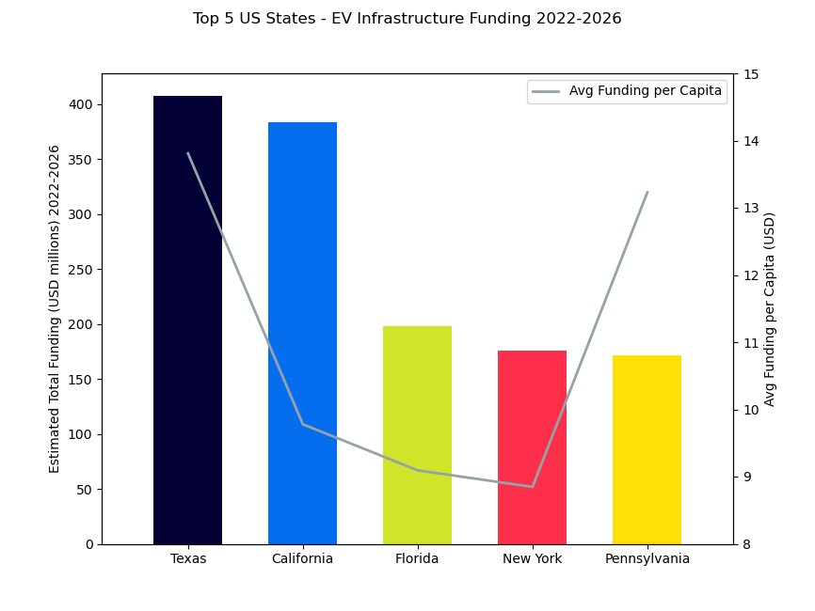
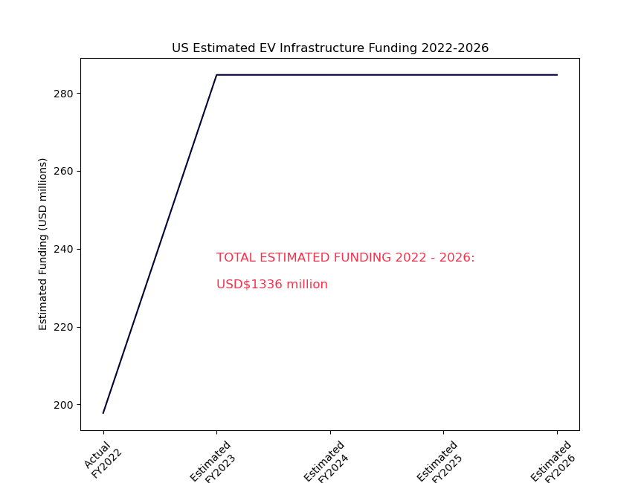
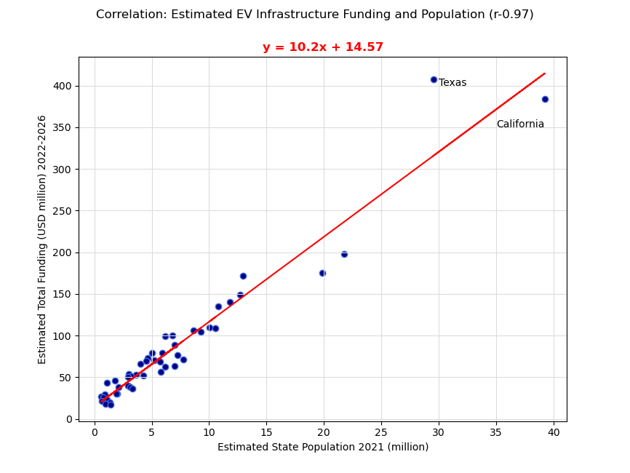
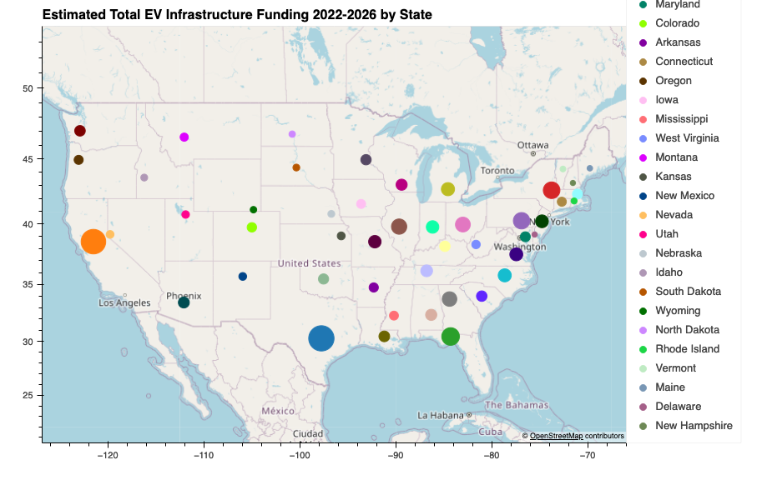
Electric Vehicle Dealership, United States
Estimated State Government EV Infrastructure Funding – 2022 to 2026
Many States within the US have committed substantial funding towards developing EV infrastructure over the period 2022 to 2026 - estimated total USD 1.3 billion.
The top 5 states in terms of estimated spend include Texas and California (being two States with the greatest populations), with Texas investing significantly more than California in terms of funding per capita.
Pennsylvania in comparison has a high average estimated spend per capita, indicating anticipated growth in the EV market.
Spend by individual States is strongly correlated to estimated population (as at 2021), with Texas estimated spend being moderately higher than other states.
Module 7, Project 1 – Group 7

Slide 3
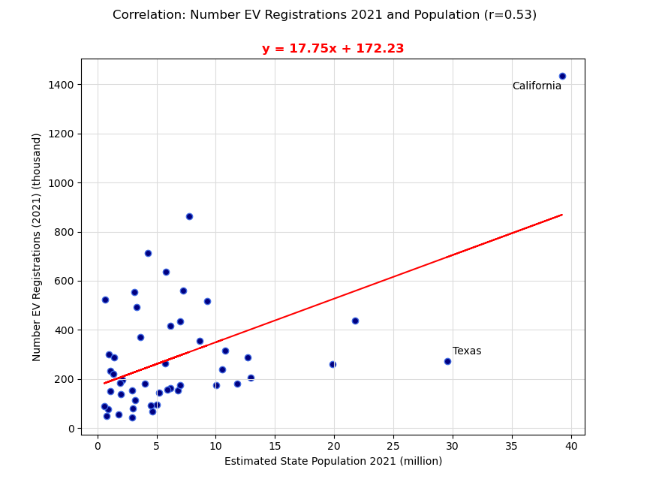
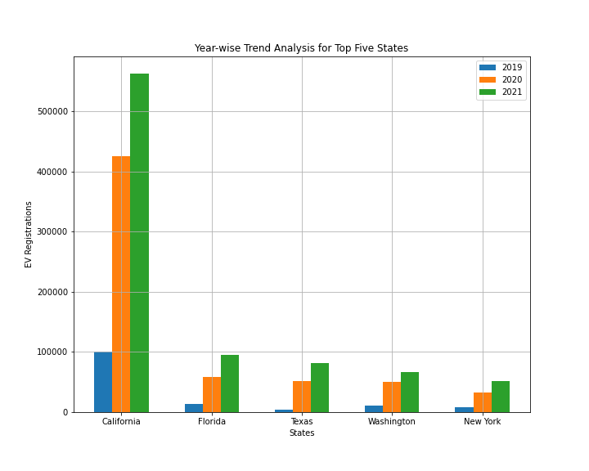
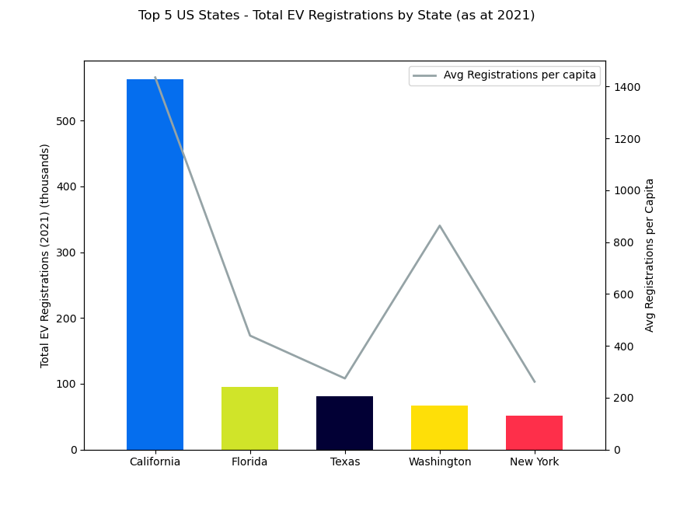
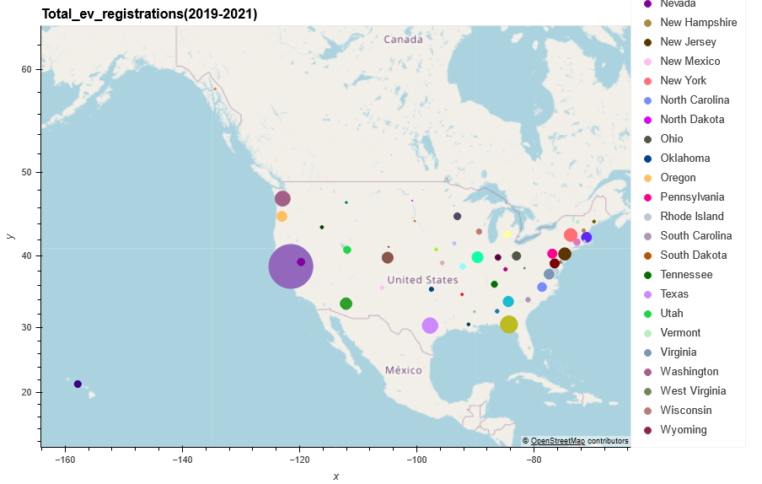
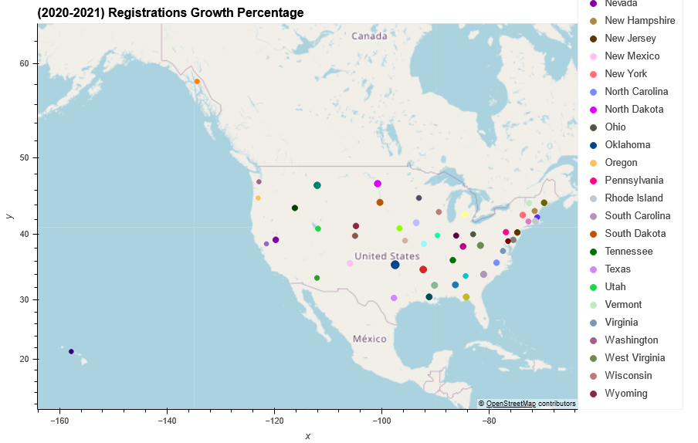
Electric Vehicle Dealership, United States
EV Registrations by State
Over the three-year period, there has been a substantial increase in EV registrations within the State of California, and steady growth within the remaining States forming the Top 5 in terms of the number of EV registrations, indicating a continued interest in sustainable transportation options.
Notably, California has a very high average registration per capita (100,000 population) when compared to other States.
The correlation between the number of EV registrations (at 2021) to population (est. 2021) is considered to be moderate.
Module 7, Project 1 – Group 7

Slide 4
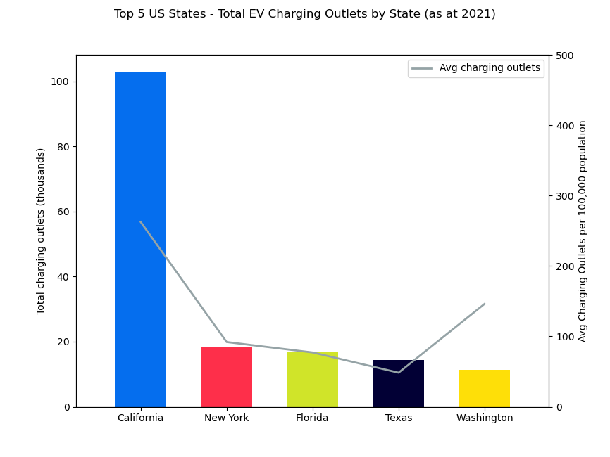
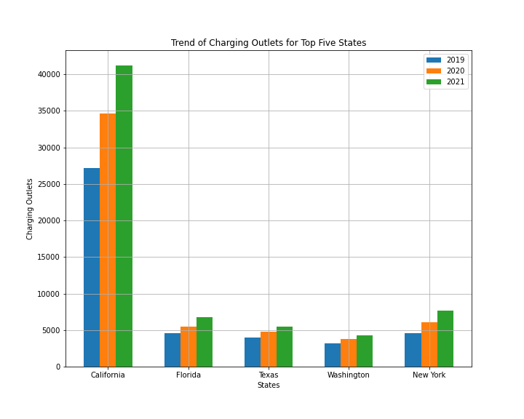
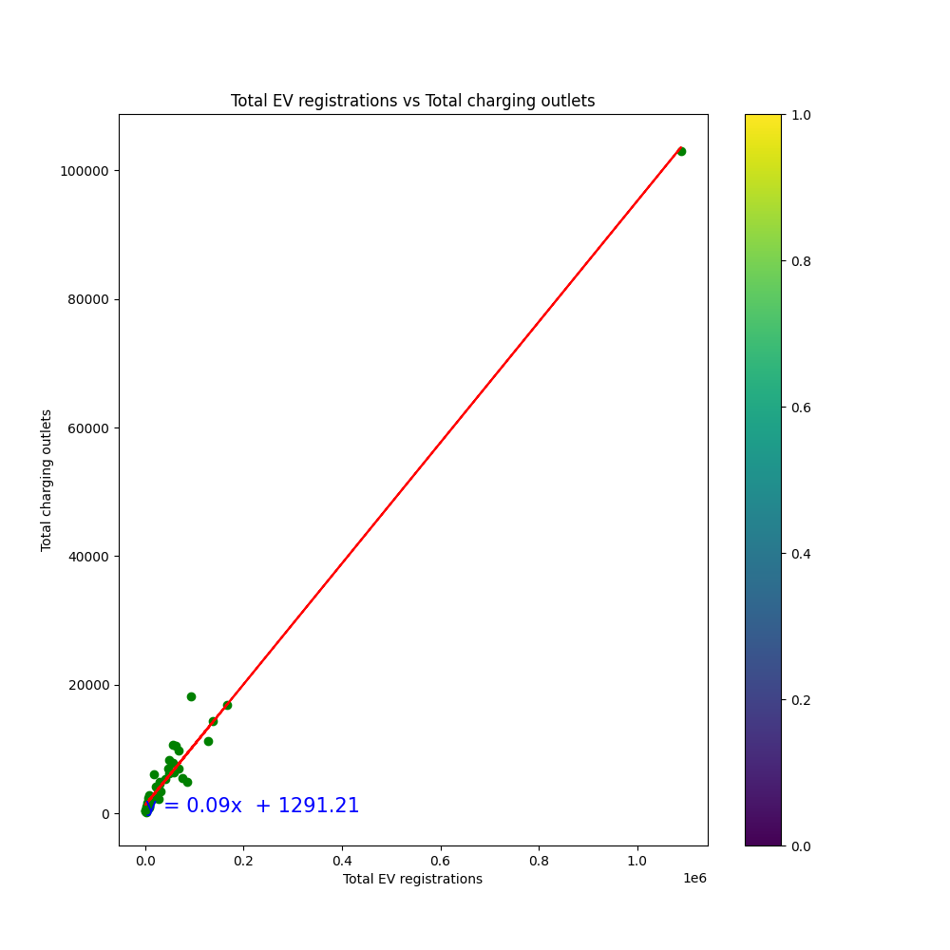
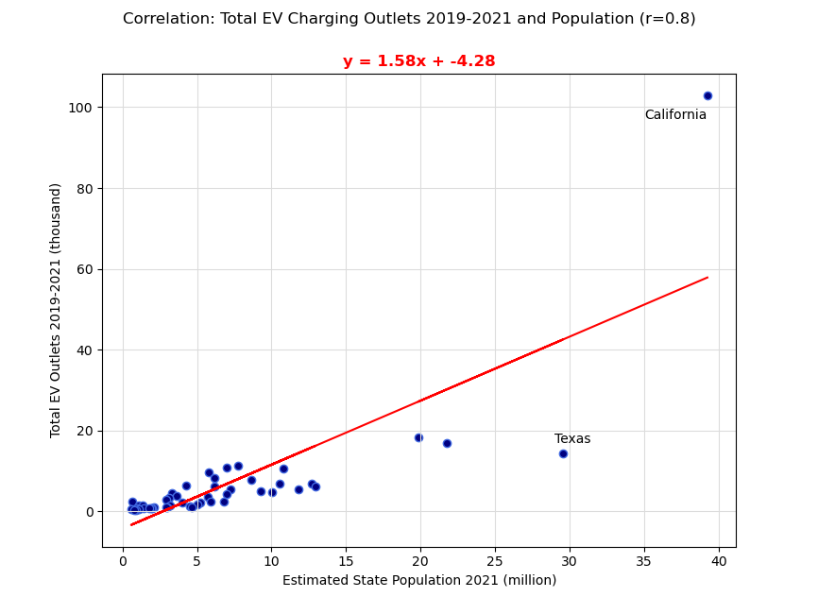
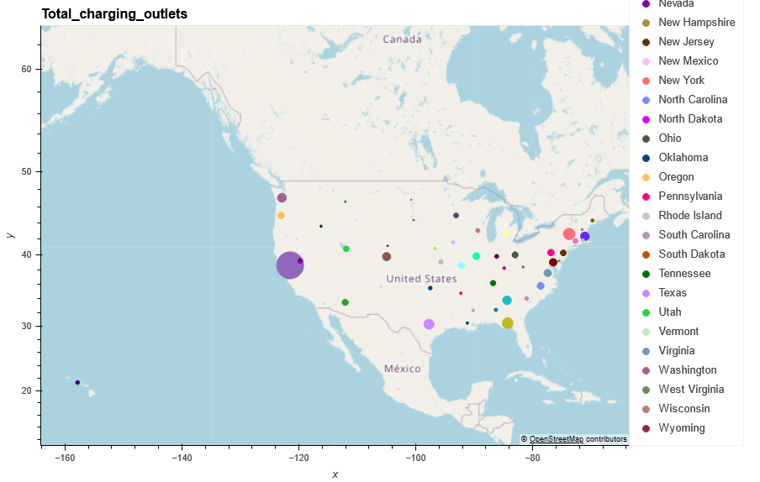
Electric Vehicle Dealership, United States
EV Charging Outlets by State
The total number EV charging outlets strongly correlates with the total number of EV registrations in each State.
The correlation between number of EV charge outlets to population is considered strong, with two notable outliers featuring within the Top 5 States by total charging outlets per capita:
California which has a greater number of charging outlets per capita; and
Texas which also has a large population currently provides notably fewer charging outlets per capita in comparison.
Module 7, Project 1 – Group 7

Slide 5
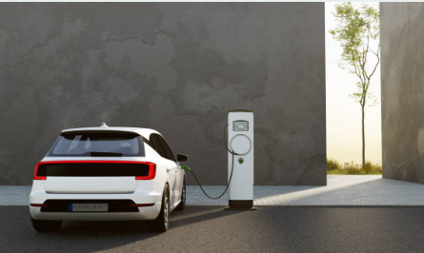
Electric Vehicle Dealership, United States
Summary
Based on the limited exploration of the subject matter, we consider there may be opportunity to establish a successful EV dealership in California or Texas.
The data analysed demonstrates that California has an established EV market with considerable existing EV infrastructure and that it is continuing to invest considerable funding into the future.
In comparison, Texas currently has a relatively smaller EV market and is investing significant funding towards EV infrastructure presumably in anticipation of considerable growth in the coming years.
However, it is recommended that our client undertake further due diligence and analysis (outlined below) prior to moving forward with any proposed business plan.
Opportunity for further analysis
Federal and State legislation and regulations relating to electric vehicles, electric vehicle infrastructure and any impacts on EV dealerships
review of detailed EV infrastructure planning and expenditure in California and Texas
EV sales data within these States
age demographics in EV sales
Estimated EV infrastructure spending per km2
Module 7, Project 1 – Group 7 image: deepblue4u, iStock by Getty Images

